Slide 1
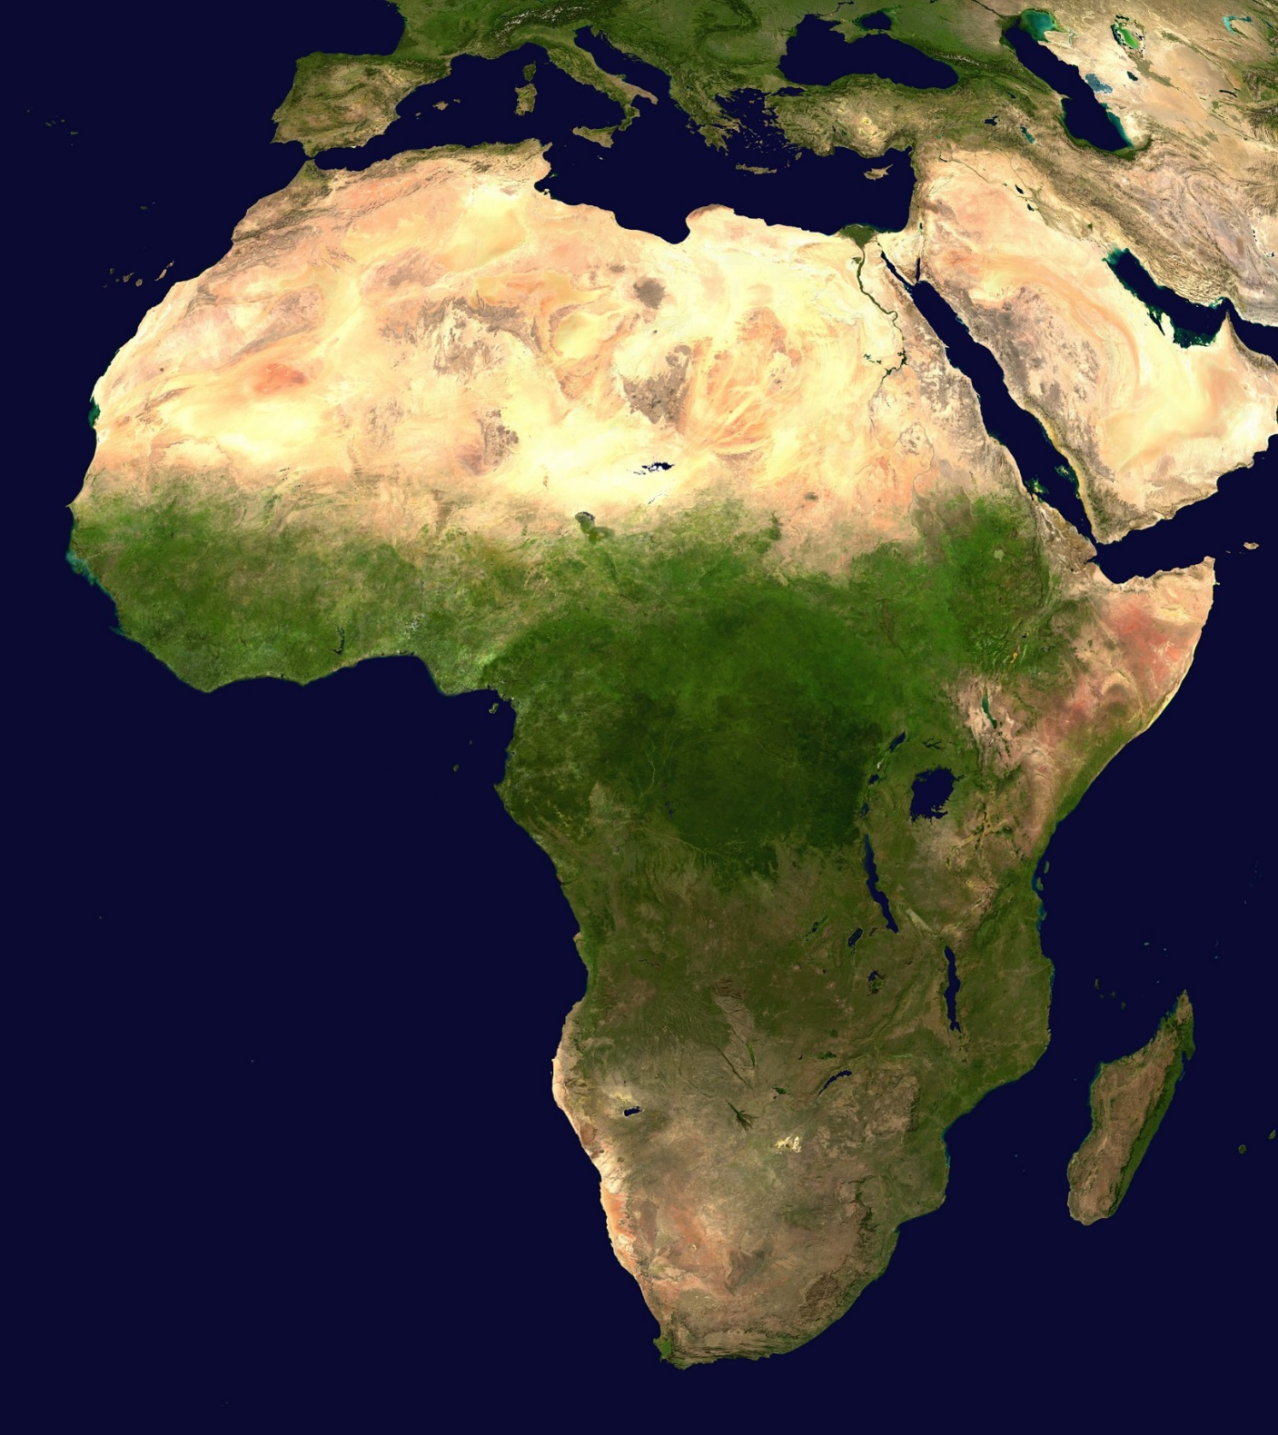
Africa’s
Geography

Slide 2
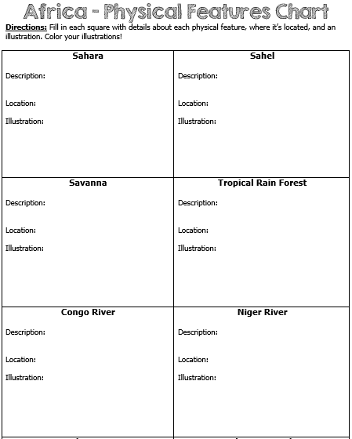

Slide 3
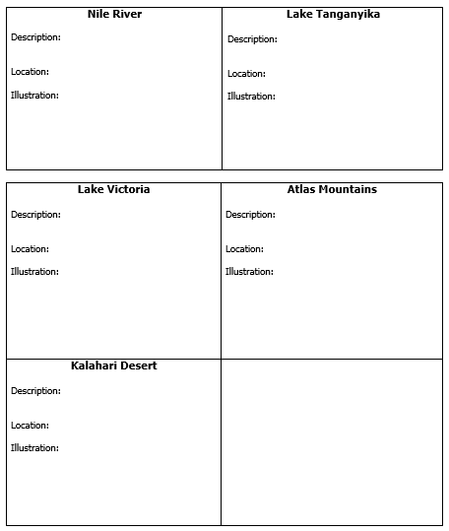

Slide 4
Warm ups
Wednesday- How do Nomads survive in the desert? Do you believe you could do this, and why?
Thursday- Why do people believe that the early traces of Human life began in Africa?
Friday-

Slide 5
Africa’s
Geography

Slide 6

Africa
Africa is the world’s second largest continent (11,700,000 miles).
It is home to 52 countries, 1,000 different languages, and 800 million people.
  10% of the world’s population lives in Africa.
The one thing that all African nations have in common is their reliance on the land’s physical characteristics, which affect where people live, work, & trade.
Africa can be divided into many different regions:
  The Sahara, the Sahel, the savannahs, the tropical rain forests, the Ethiopian Highlands, and Southern Africa.

Slide 7
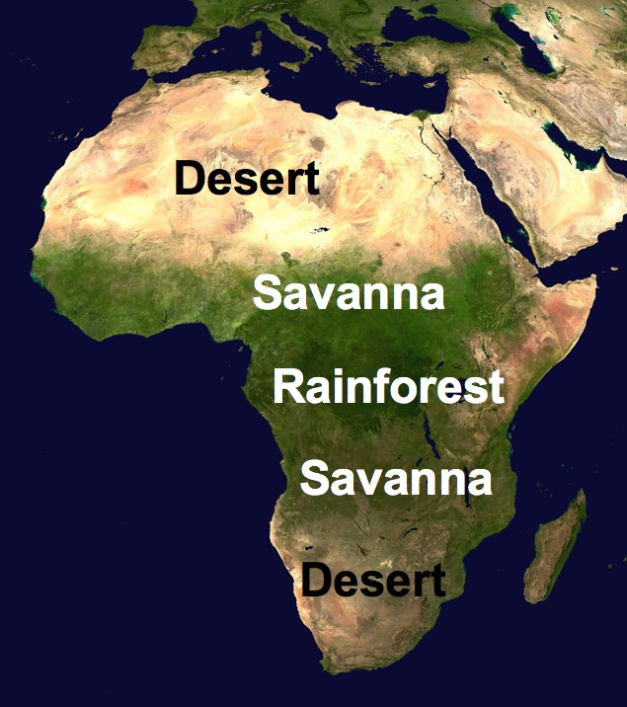

Slide 8
Sahara Desert
The Sahara is the world’s largest desert (3,500,000 miles).
  It runs across the width of northern Africa.
  It covers 1/3rd of the continent.
It divides the continent into two distinct regions – North Africa and sub-Saharan Africa.
The Sahara is covered with sand dunes, rocky hills, and stretches of gravel
Very few people live in the desert because it is considered one of the harshest places to live in the world.
  The people who do live here are called nomads.
  They move from place to place, usually traveling by camel, looking for food & water.

Slide 9
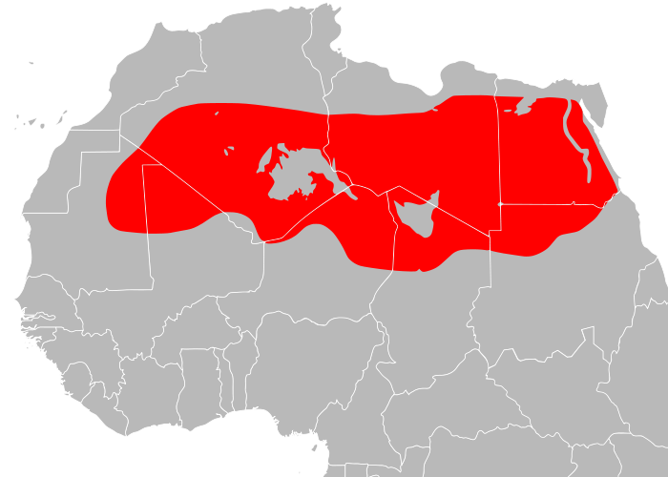

Slide 10
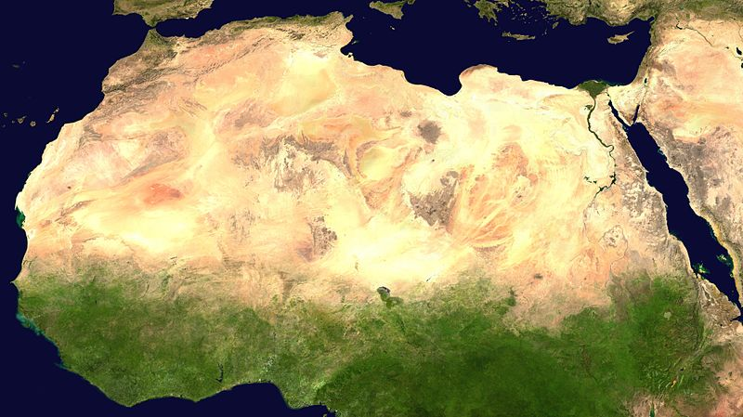

Slide 11
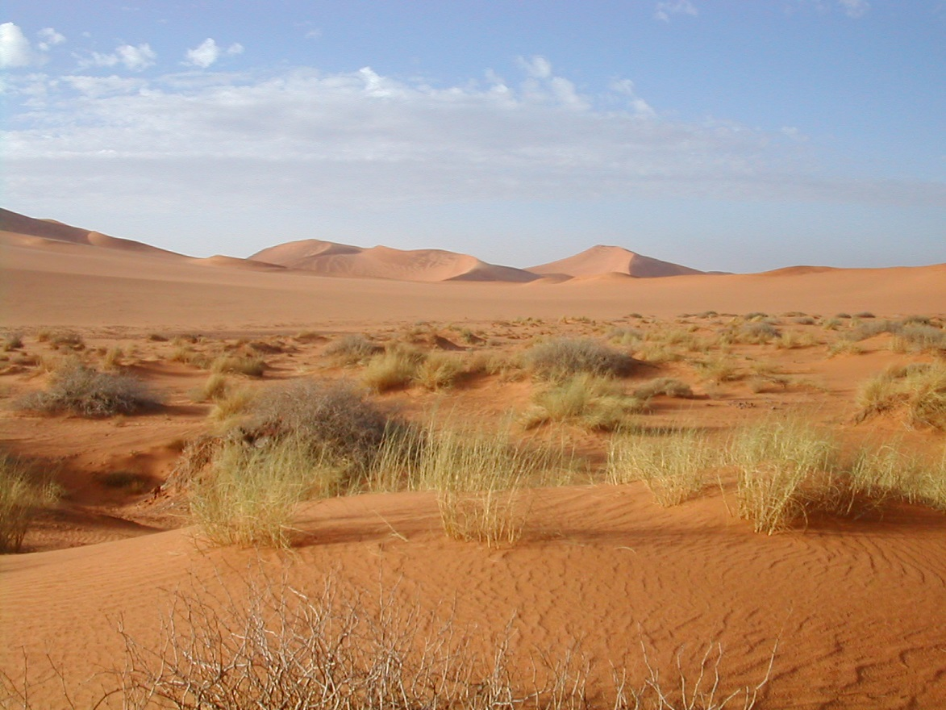

Slide 12
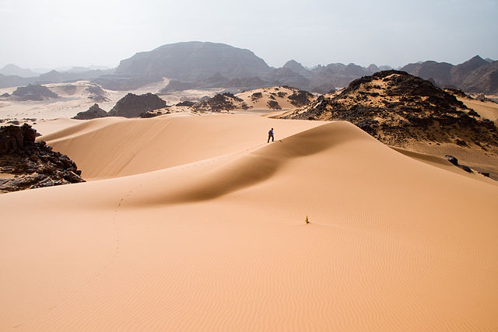

Slide 13
The Sahel
The Sahel is a strip of dry grassland that is located south of the Sahara.
  The word “Sahel” means “border” or “margin”.
  It is the region between the desert to the north and the grasslands and rainforest to the south.
It is a dry, semi-arid region that is slowly turning into desert.
  It gets more rainfall than the desert, but still receives very little, ranging from 6-20 inches.
People have tried to live here but generations of overgrazing and desertification have caused soil erosion.
  Vegetation is sparse here—grasses are shrubs are unevenly distributed.
The Sahel is relatively flat with few mountains and hills.

Slide 14
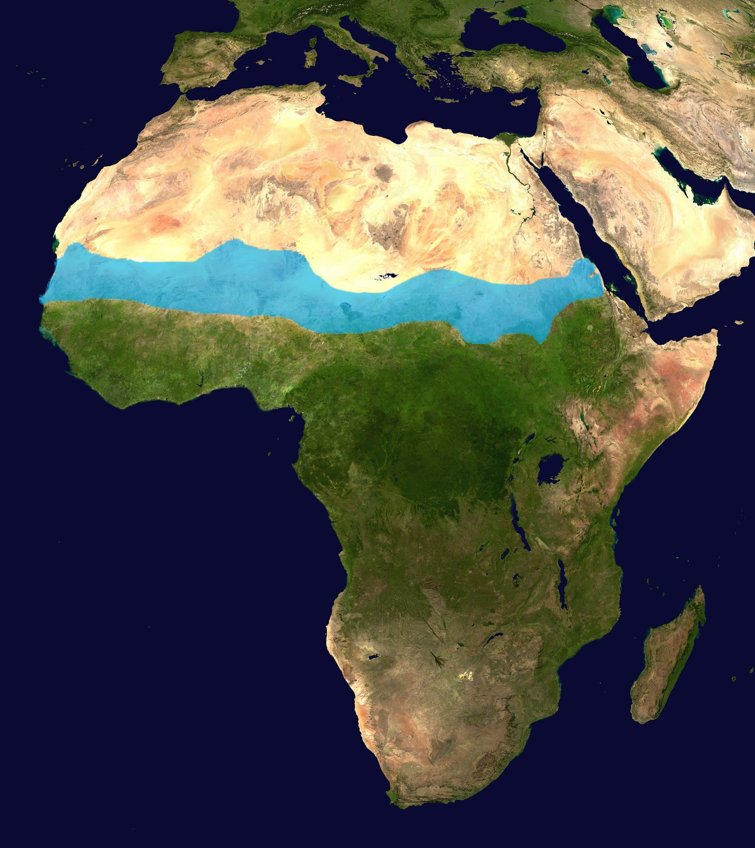
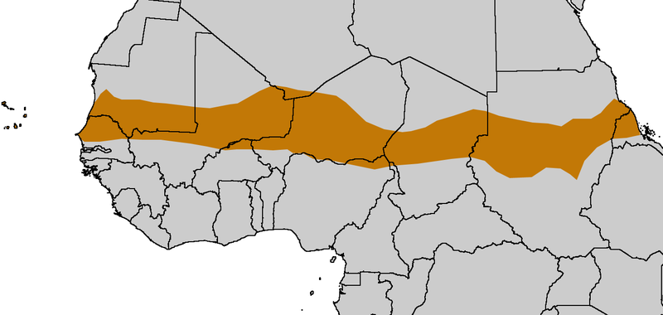

Slide 15
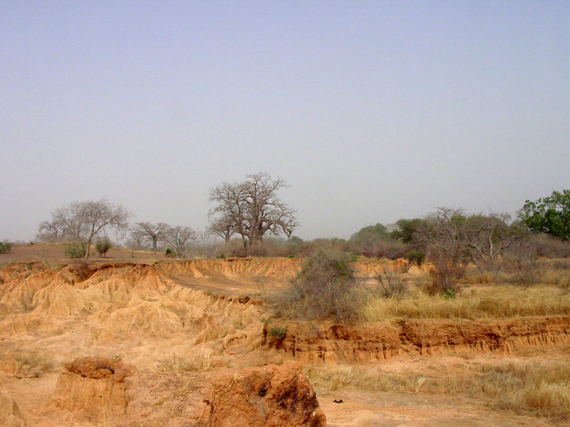

Slide 16
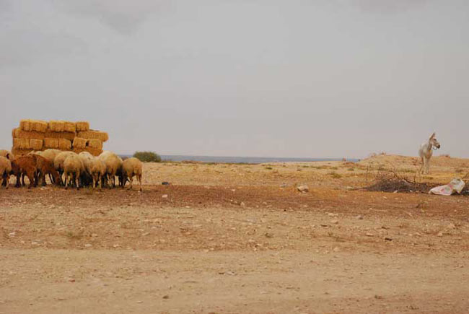

Slide 17
Savanna
The African savannas are hot, dry grasslands that are located near the Equator and cover almost half of Africa.
  They actually cover the regions just north and south of the rainforests that lie along the equator.
The African savanna is the largest in the world.
  There is a large variety of wildlife here, including lions, zebras, & elephants.
Farming is good here, but only if there is good rainfall.
  Grasses and grains like wheat, oats, and sorghum grown in the region.
The area receives enough rain to support drought resistant undergrowth, but not enough to support forest-type vegetation.
  Grasses are tall and thick, while trees are short and scattered.

Slide 18
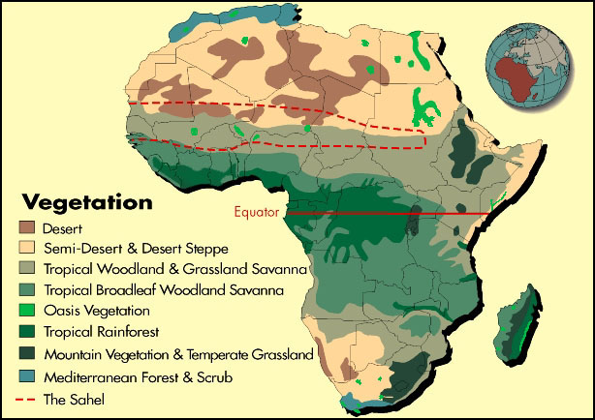

Slide 19
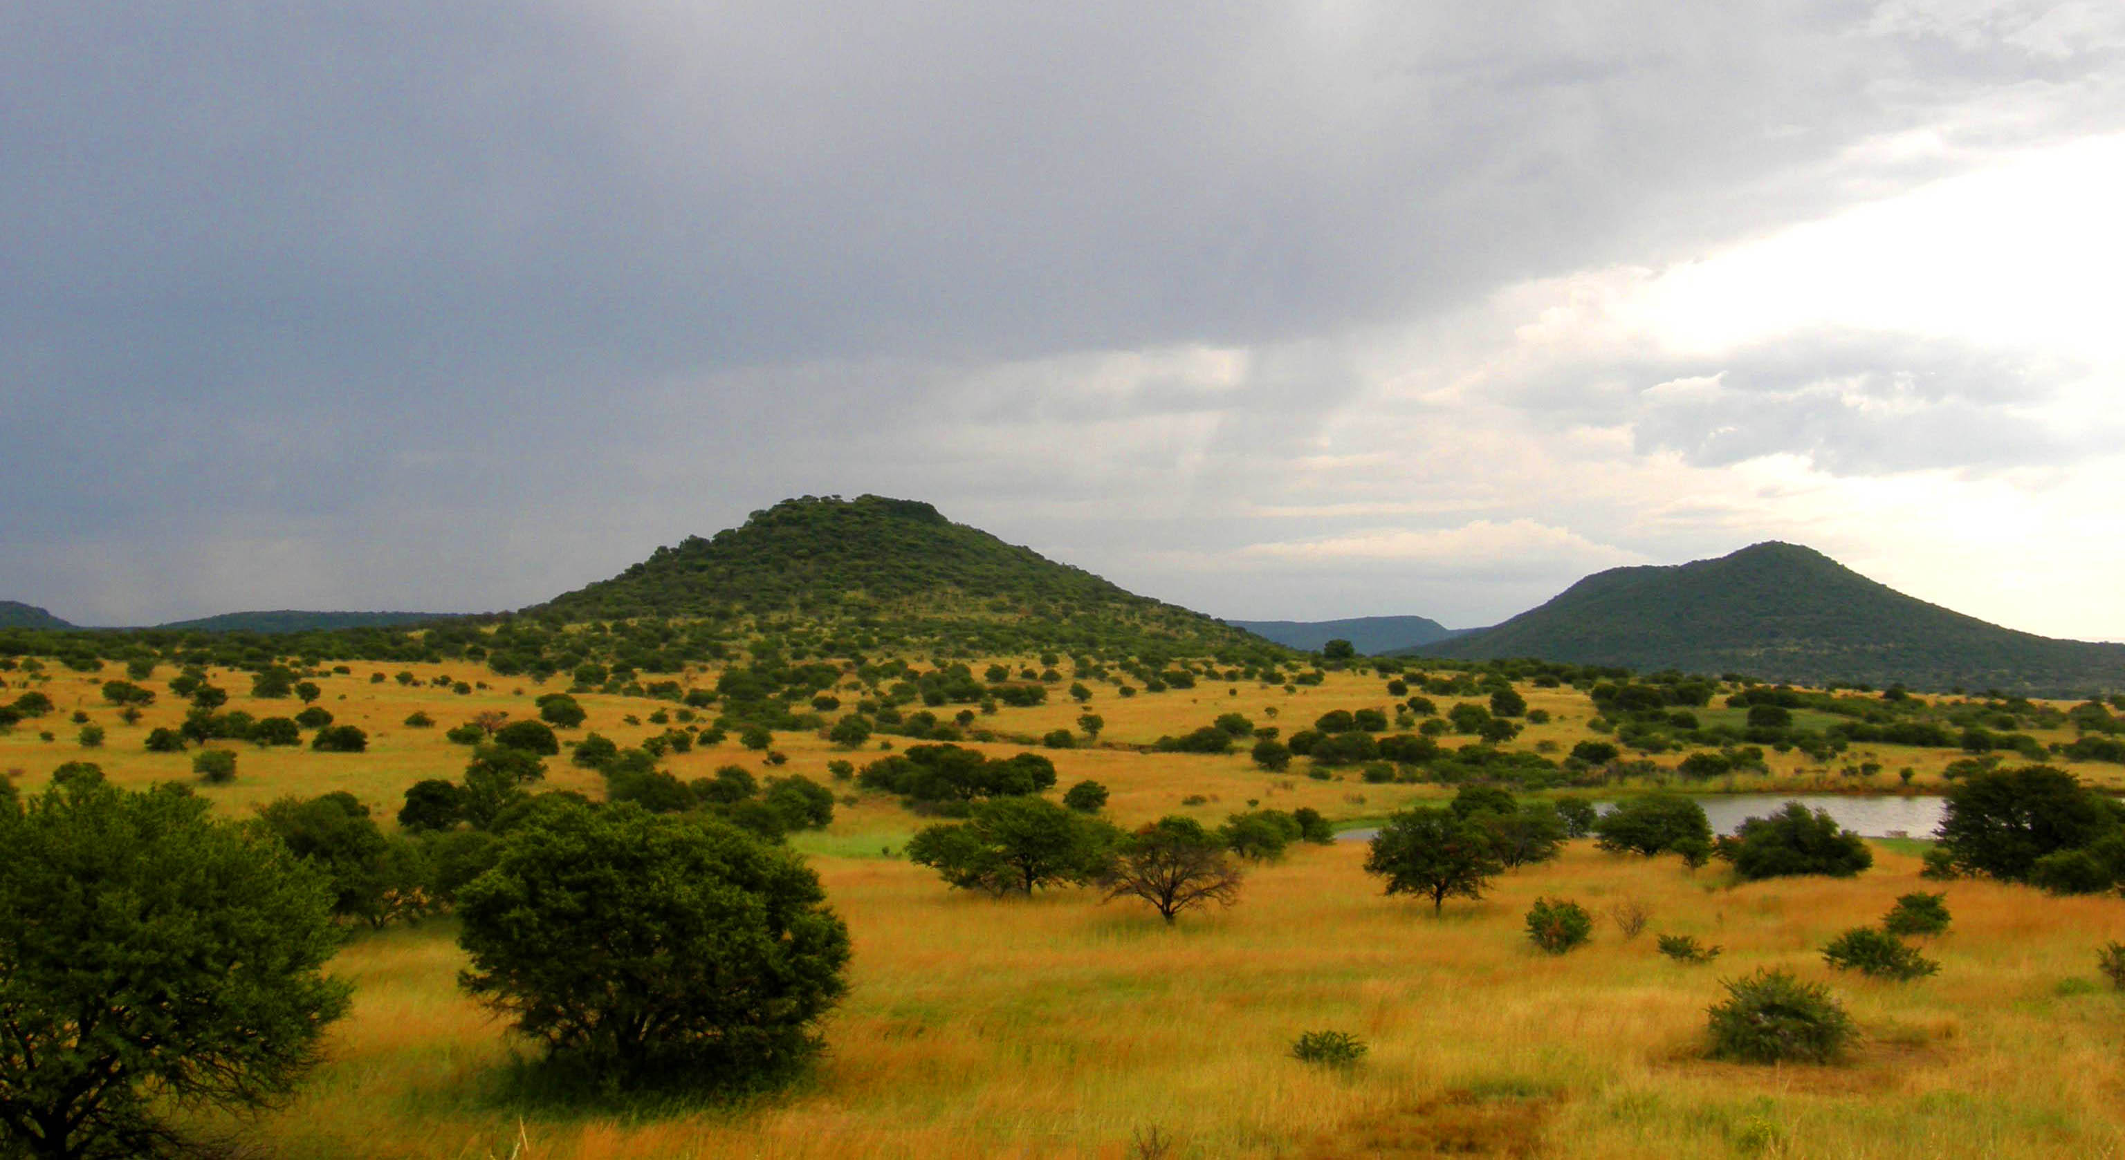

Slide 20
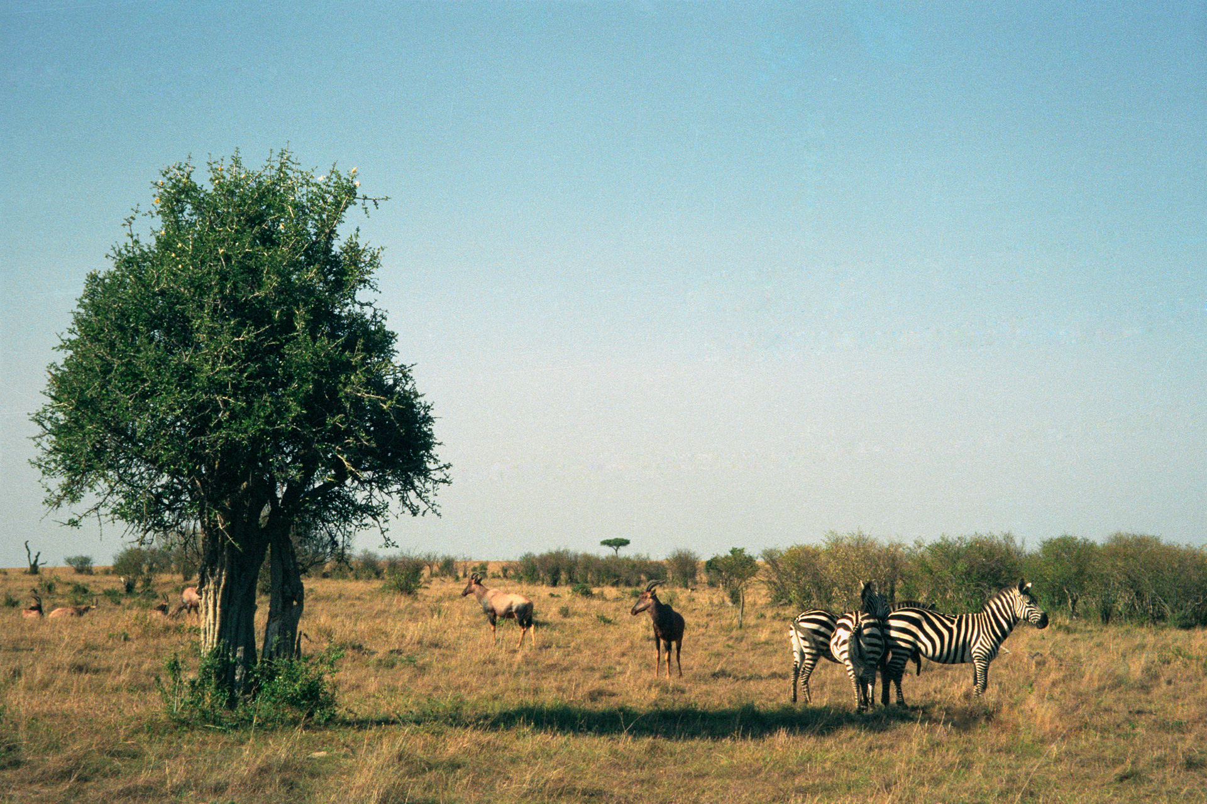

Slide 21
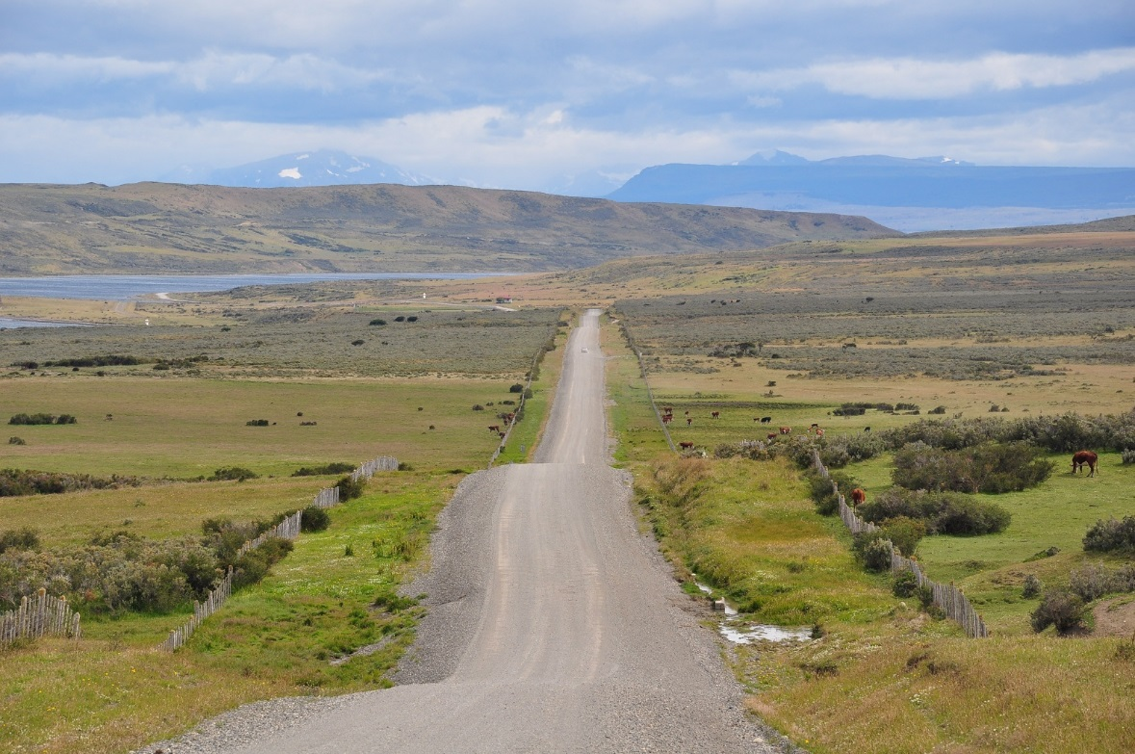

Slide 22
Tropical Rain Forest
Africa’s tropical rain forest is located along the central coast of Africa, near the Equator.
  It lies in the Congo River Basin.
The rain forest covers 1/5th of the land surface of Africa and touches 37 countries.
  The rain forest has a hot, humid climate.
  The annual rainfall is over 17 feet.
  There is a large variety of animals found in this region.
Trees are so thick and tall that sunlight never reaches the forest floor!
  The trees grow hundreds of feet tall.
It’s the second largest rain forest in the world; the Amazon rain forest in Brazil is the largest.
  Unfortunately, this rain forest has shrunk due to deforestation.
.

Slide 23
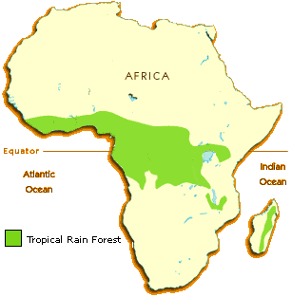

Slide 24
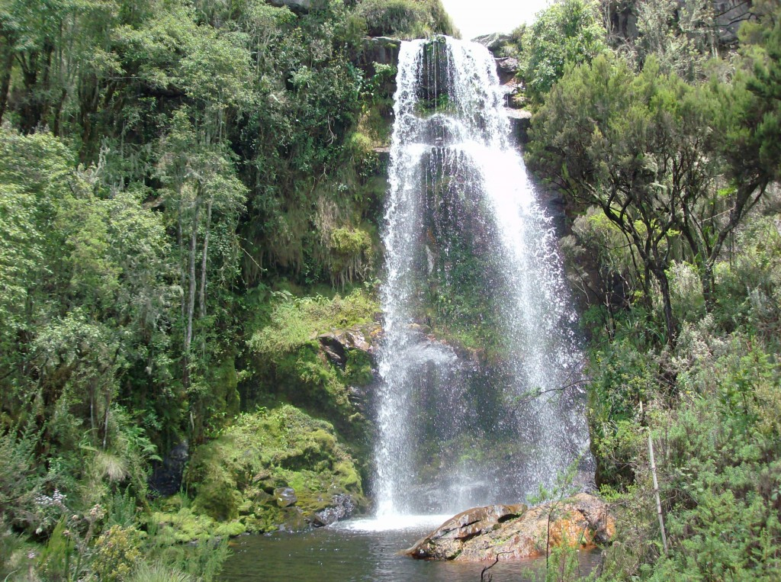

Slide 25
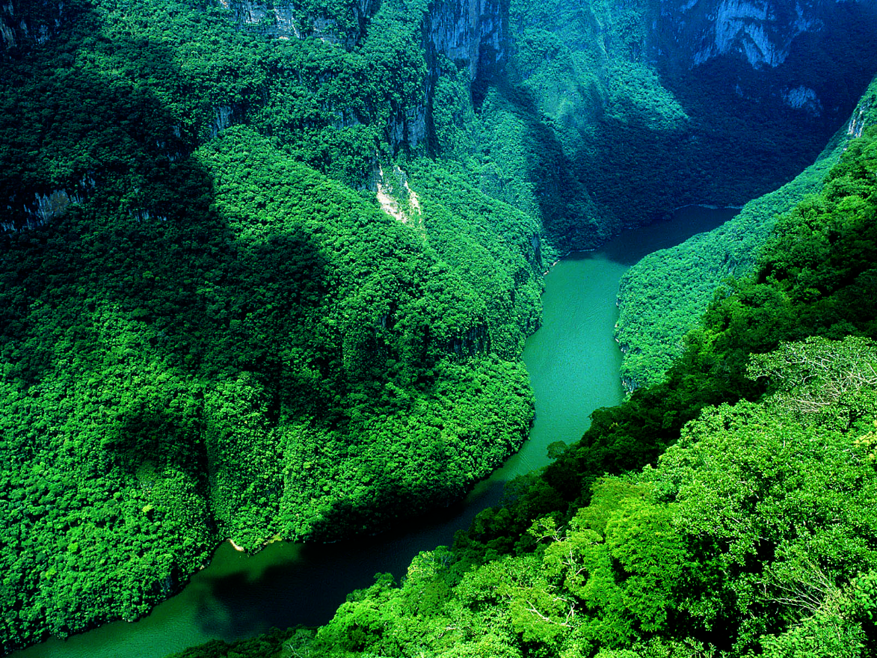

Slide 26
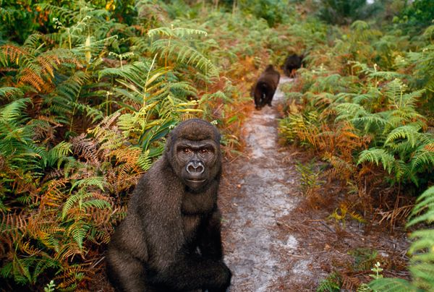

Slide 27
Congo River
The Congo River is located in western central Africa.
  It begins in central Africa, near Lake Tanganyika, and flows west through the tropical rain forest.
The Congo River is the second largest river in Africa.
  It’s over 3,000 miles long.

Slide 28
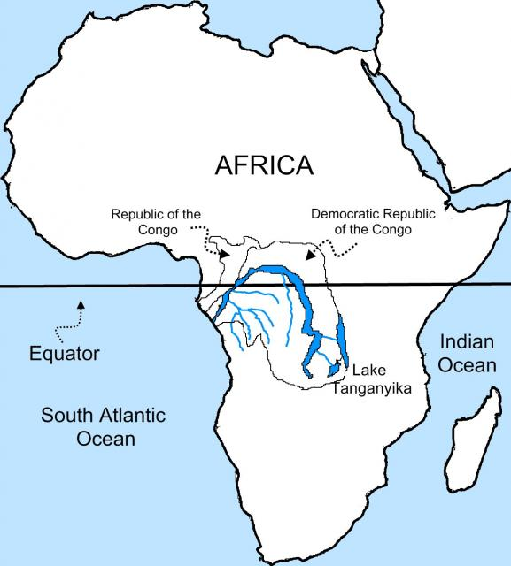

Slide 29
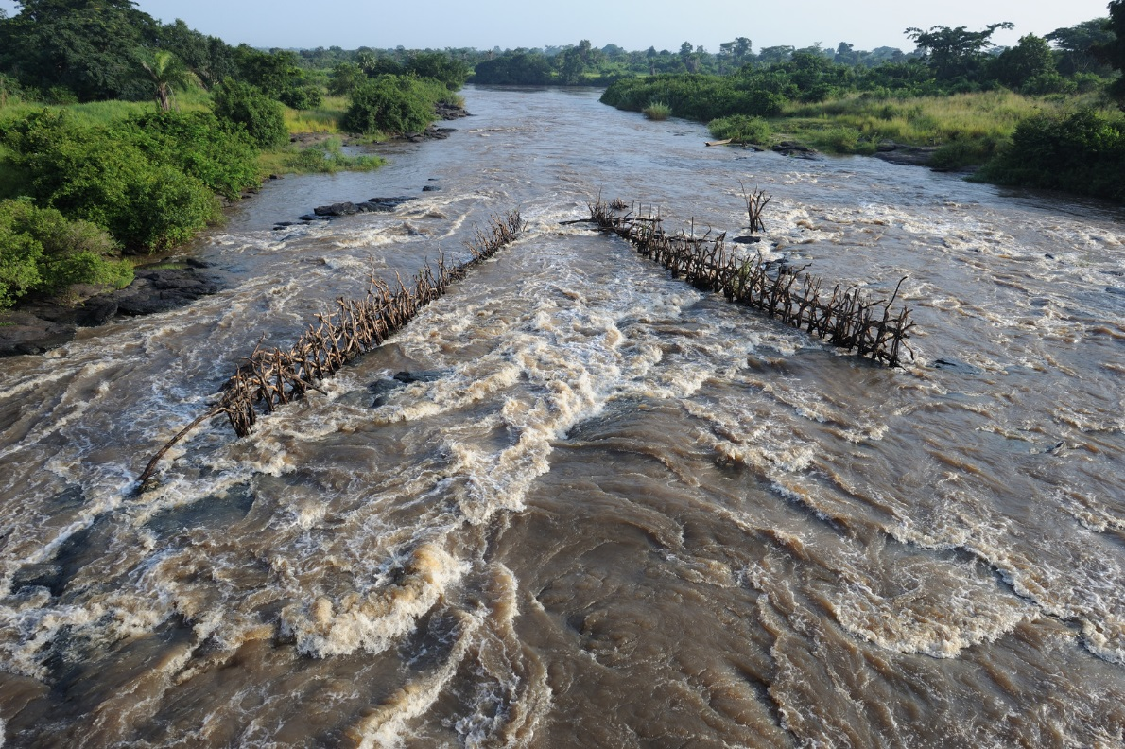

Slide 30
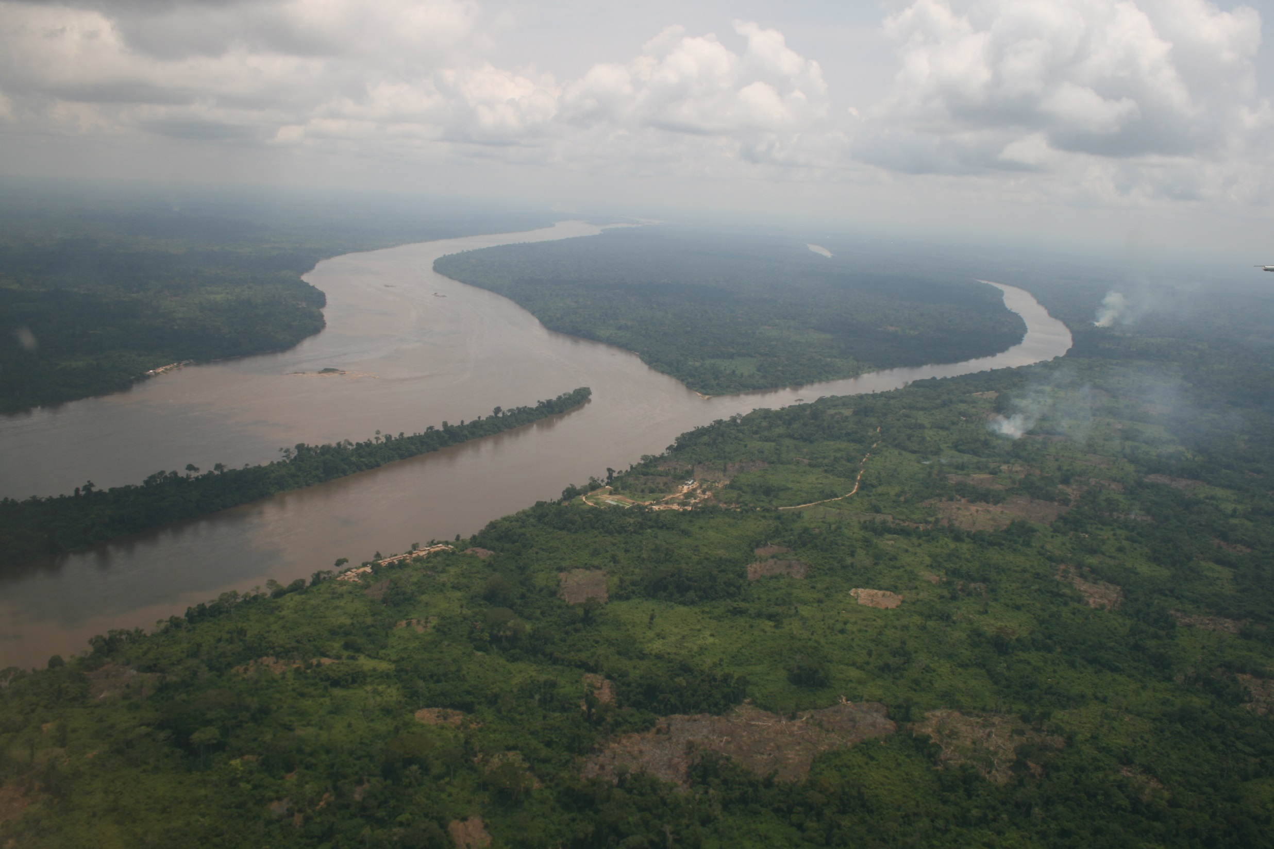

Slide 31
Niger River
The Niger River is located in western Africa.
  It flows through Guinea, Mali, Niger, Benin, & Nigeria.
The Niger River is the third largest river in Africa.
  It runs over 2,600 miles.
The mouth of the Niger River flows through a large delta, often referred to as the “Oil Delta” because of the petroleum industry that’s centered here.

Slide 32
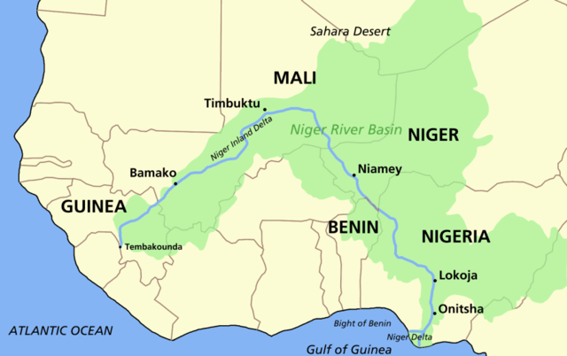

Slide 33
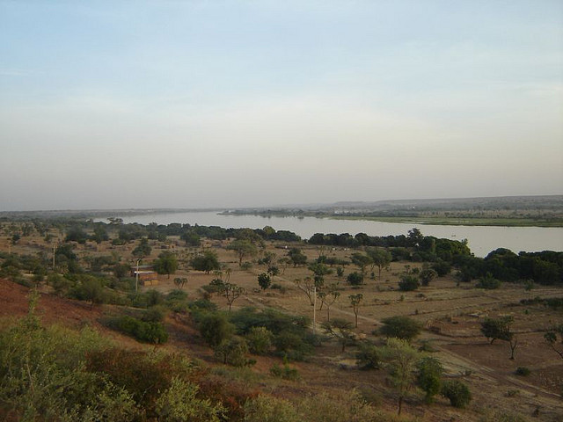

Slide 34
Nile River
The Nile River is located in eastern Africa.
  It starts in East Burundi and flows northward and empties into the Mediterranean Sea.
The Nile is the world’s longest river at 4,150 miles.
It provides water for Sudan and Egypt.
It’s an important waterway for transporting people and goods.
The Nile also provides a source of irrigation for agriculture.

Slide 35
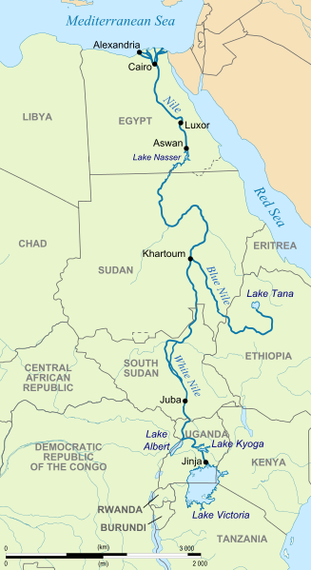

Slide 36
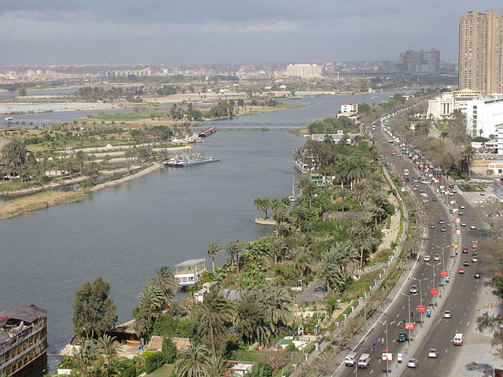

Slide 37
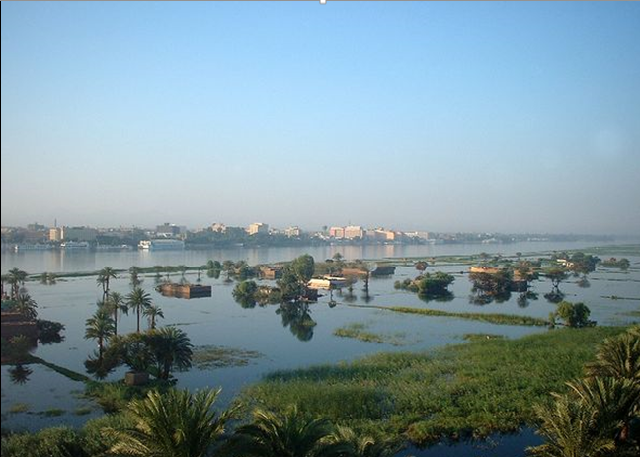

Slide 38
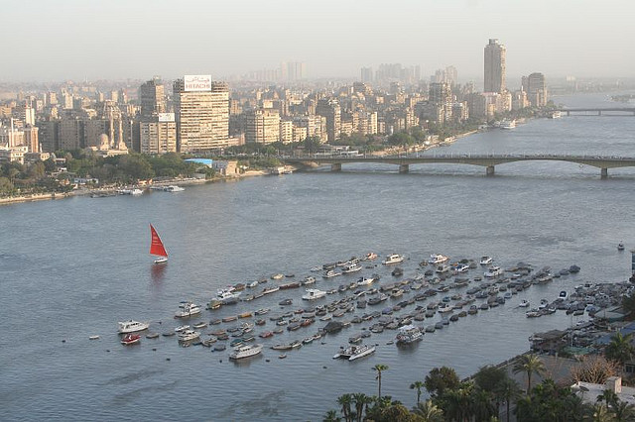

Slide 39
Lake Tanganyika
Lake Tanganyika is located in central Africa.
  It’s divided between Burundi, Congo, Tanzania, and Zambia.
Lake Tanganyika is the deepest lake in Africa and one of the deepest in the world.
It’s also one of the largest freshwater lakes in the world.

Slide 40
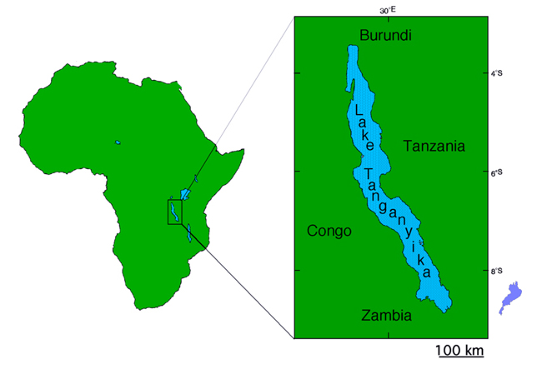

Slide 41
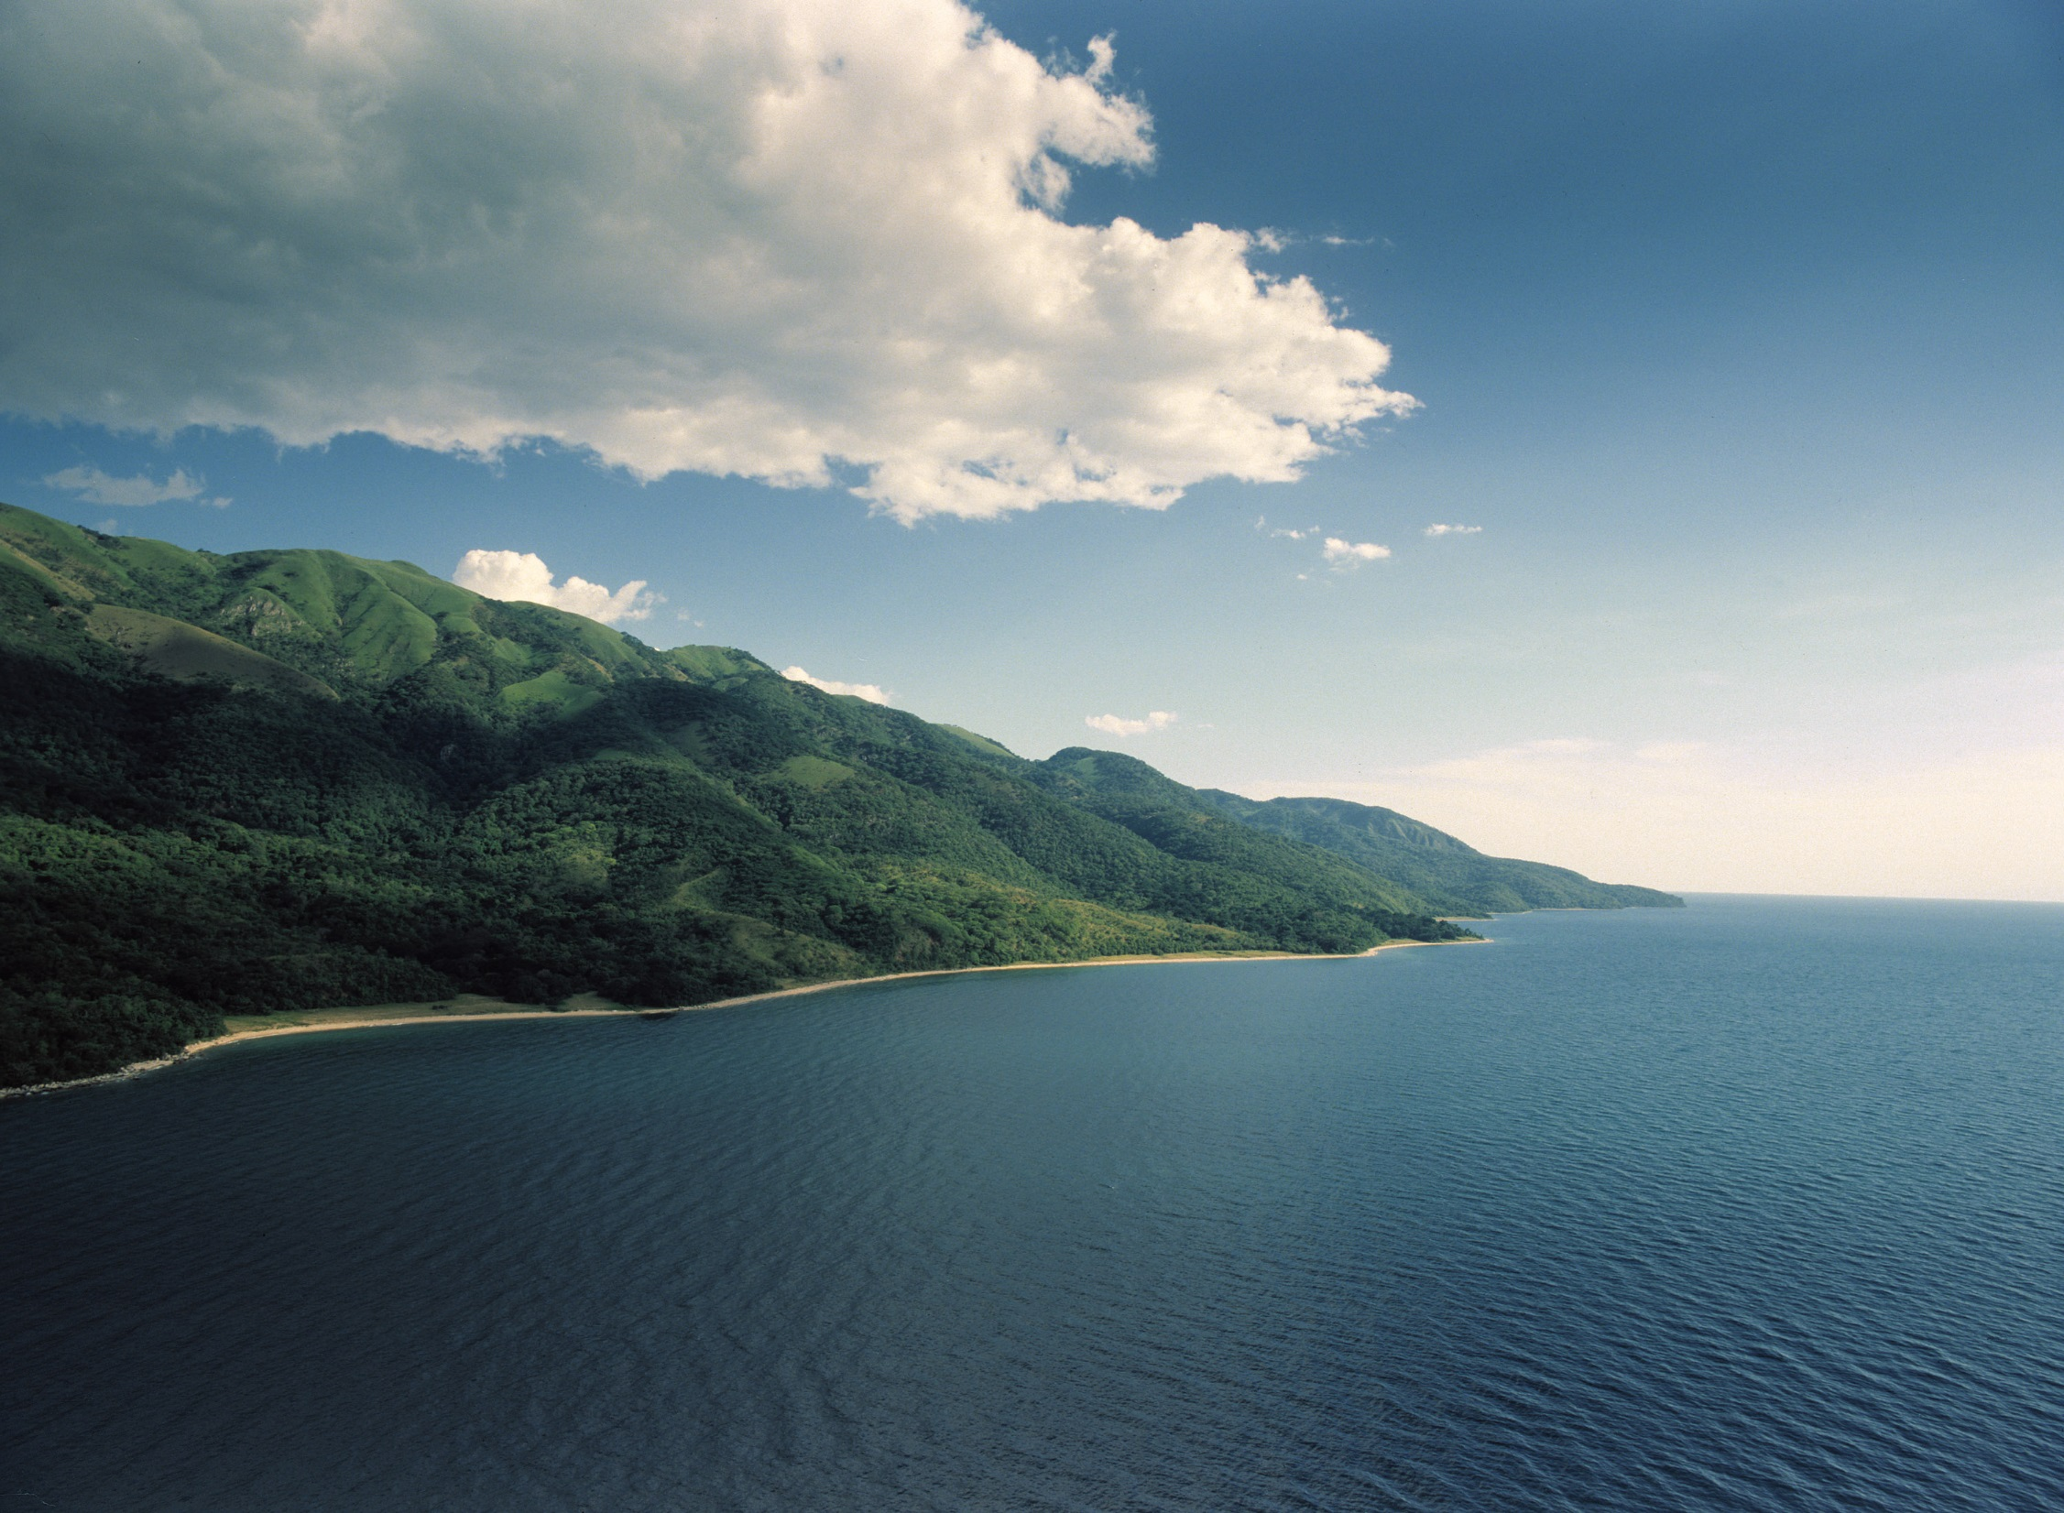

Slide 42
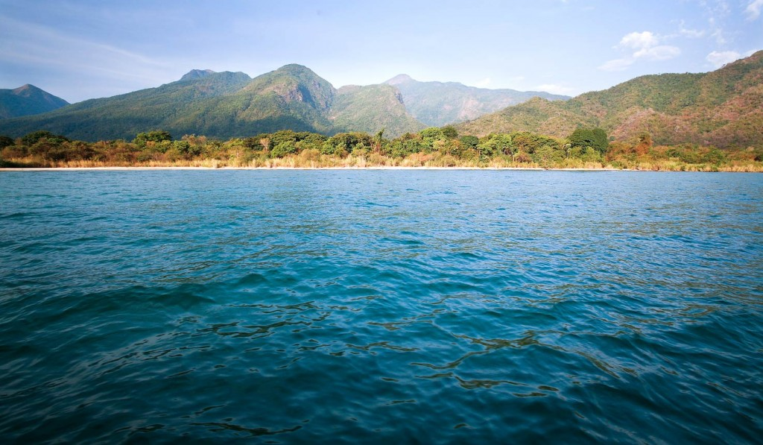

Slide 43
Lake Victoria
Lake Victoria is the largest lake in Africa and the second largest freshwater lake in the world (Lake Superior is the largest).
It is located in central Africa and extends into three countries: Tanzania, Uganda, and Kenya.
  White Nile begins here.
Lake Victoria is vital in supporting the millions of people that live nearby.
  It provides a living for many fishermen and attracts millions of tourists each year.

Slide 44
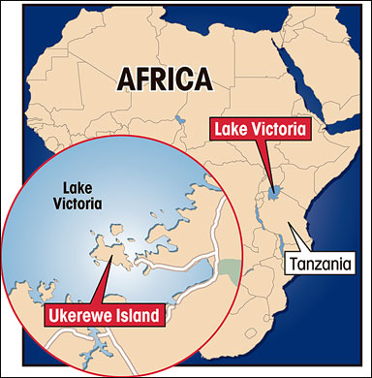

Slide 45
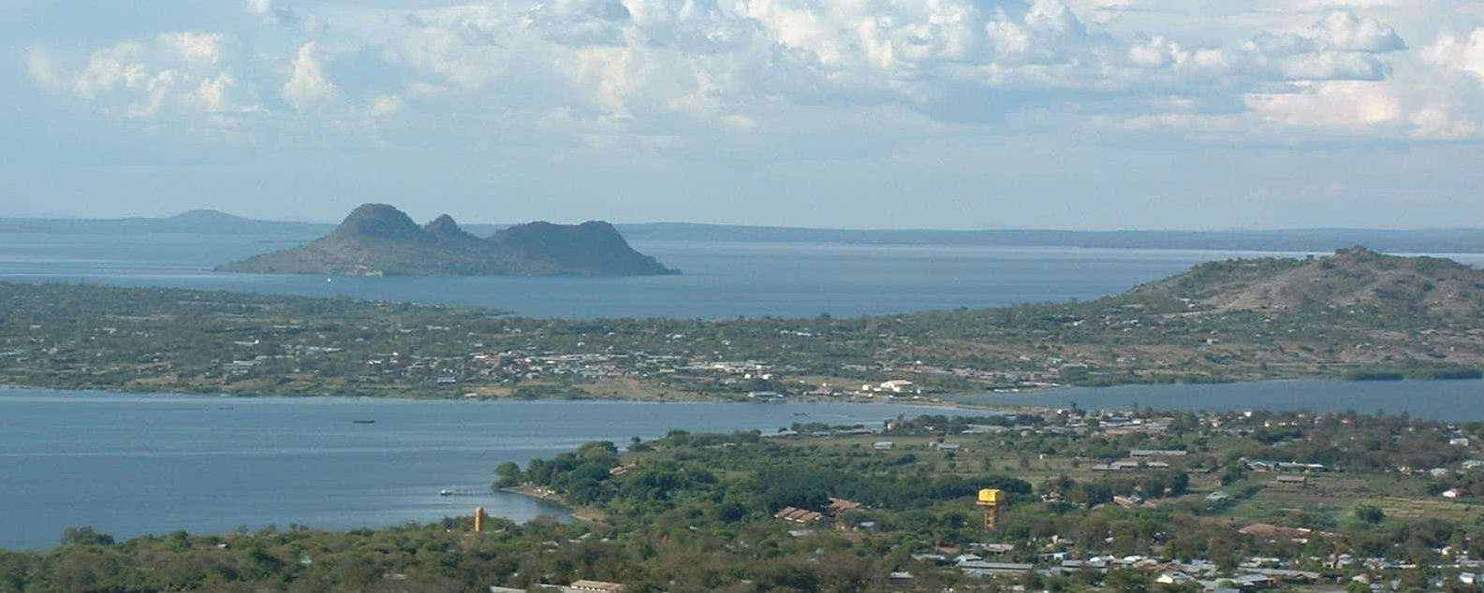

Slide 46
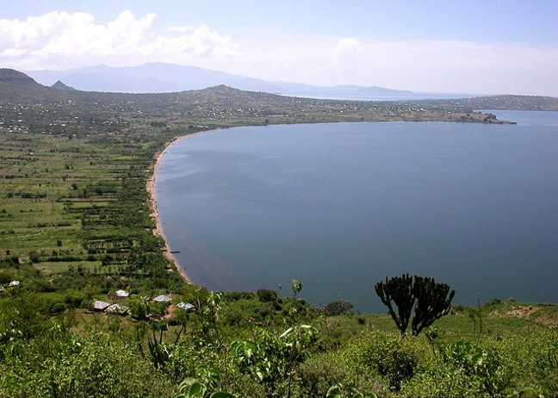

Slide 47
Atlas Mountains
The Atlas Mountains are a mountain range in north Africa.
The mountains extend from Morocco to Tunisia, between the Mediterranean Sea and the Sahara desert.
They separate the coastal regions from the Sahara Desert.

Slide 48
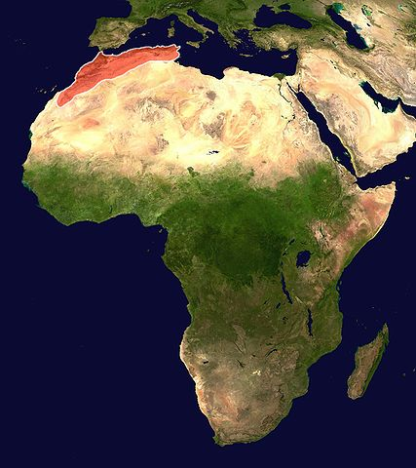

Slide 49
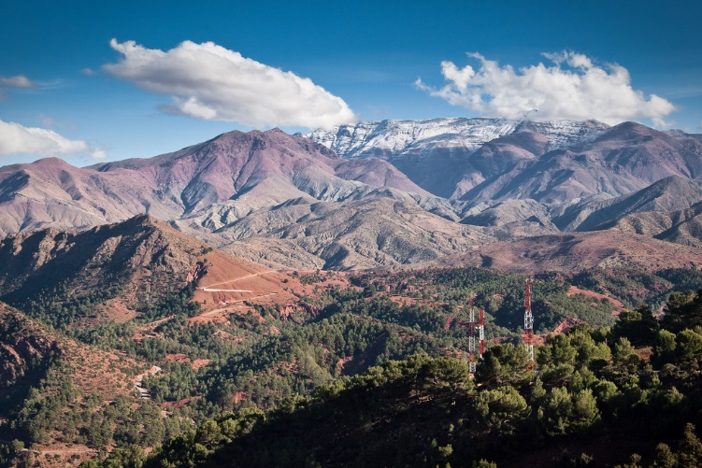

Slide 50
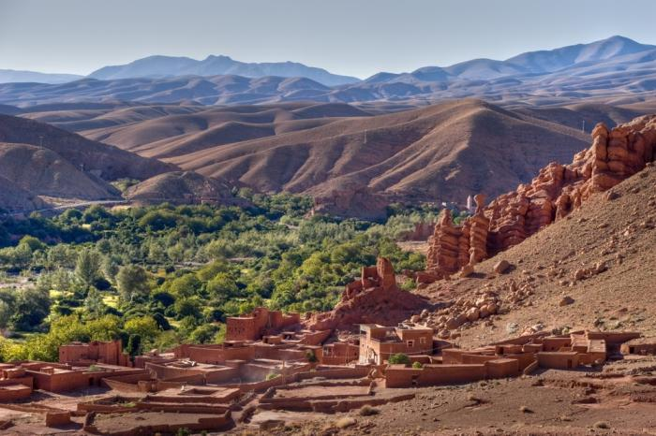

Slide 51
Kalahari Desert
The Kalahari Desert is located in southwestern Africa.
  It covers parts of Botswana, Namibia, and South Africa.
The region is surrounded by semi-arid areas that are slowly becoming more dry.
It is not a “true” desert because it receives 3-10 inches of rain per year.
Because of the precipitation and underground water supplies, grass, shrubs, and wild animals manage to live in the Kalahari desert.

Slide 52
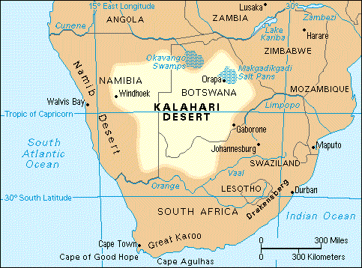

Slide 53
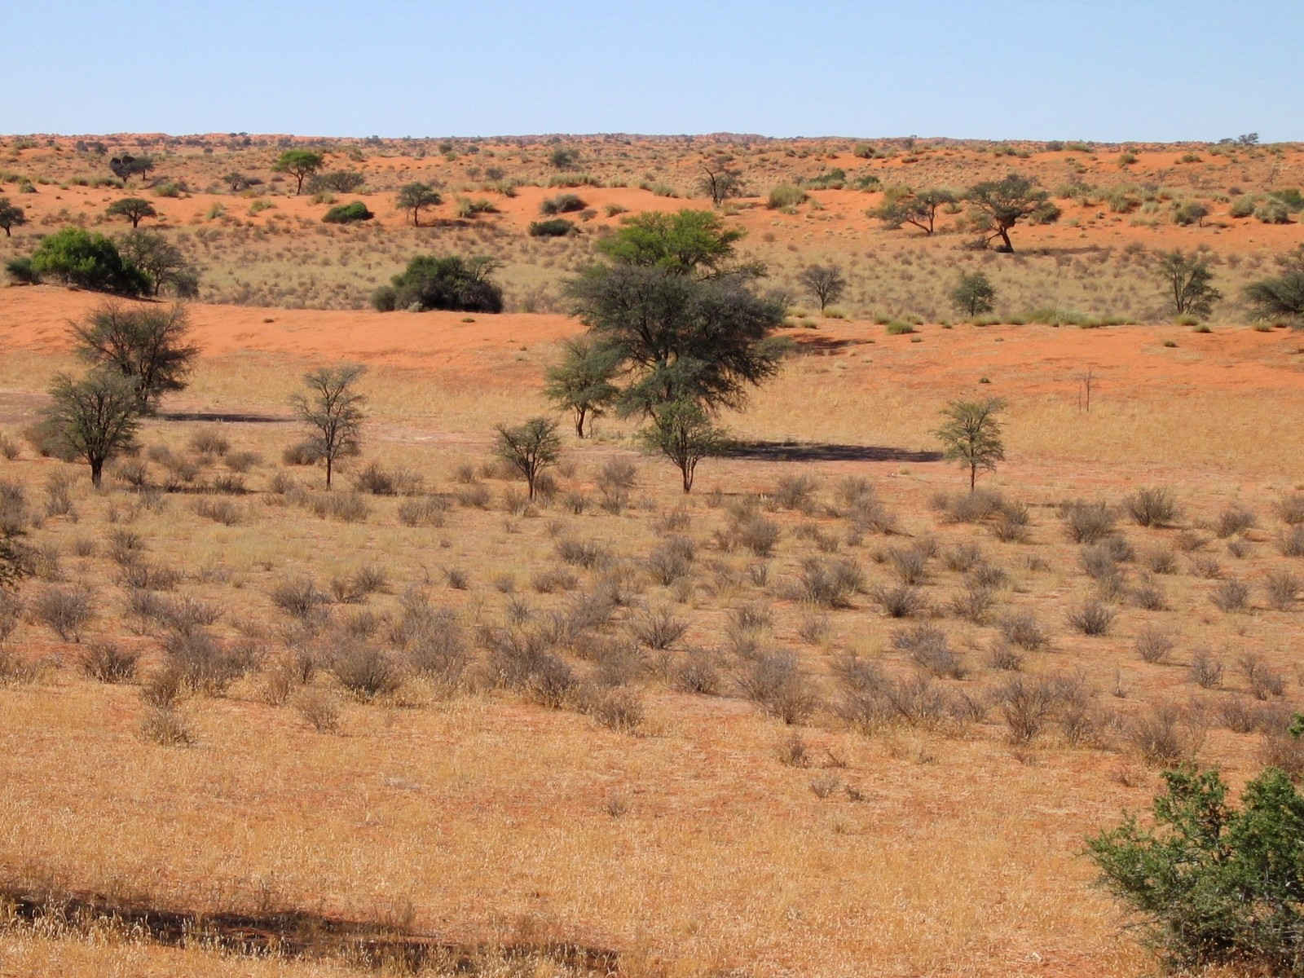

Slide 54
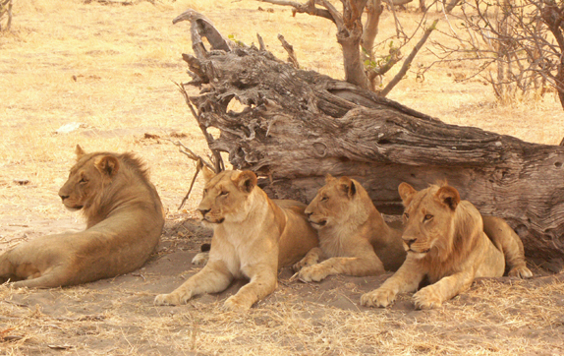

Slide 55
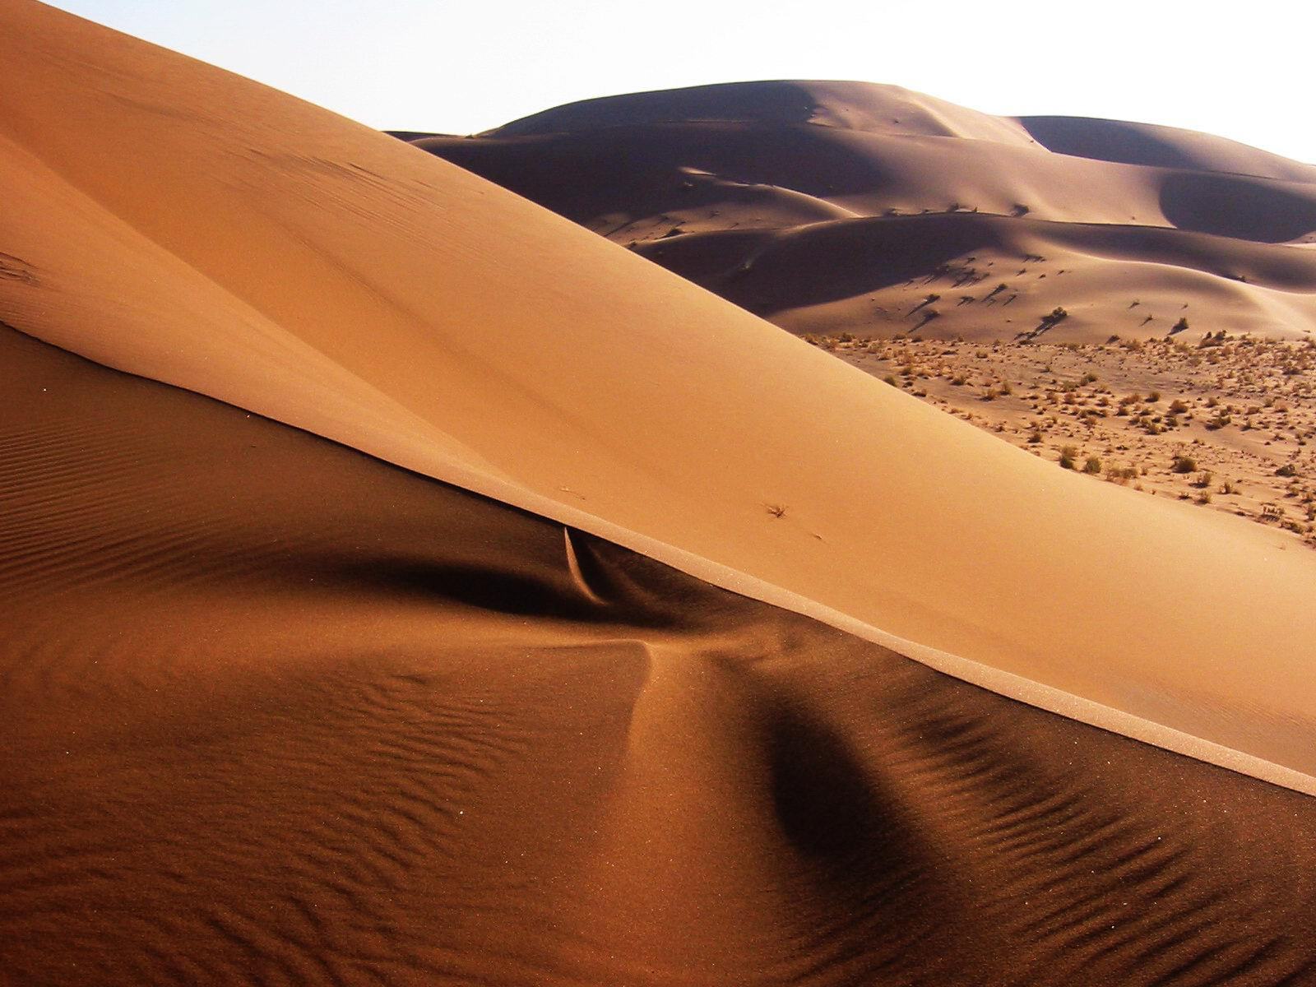

Slide 56
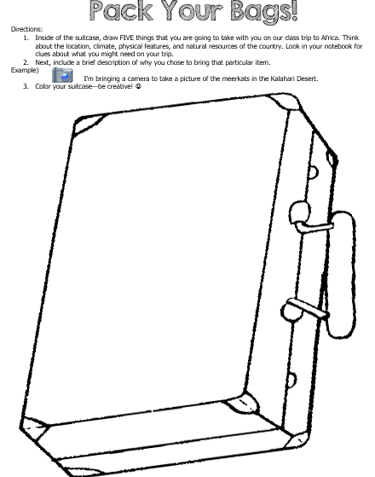

Slide 57
Physical Features Class Quilt – Teacher Directions
Divide the class into groups of 11 .
Give each student a quilt patch handout.
Each student will create a “quilt patch” for 1 of the 11 physical features in Africa.
Have the students tape all 11 patches together to create the “quilt”.
*To make the quilt “even”, have the students work together to make a patch about Africa in general (size, features, people, climate, location, etc.)

Slide 58
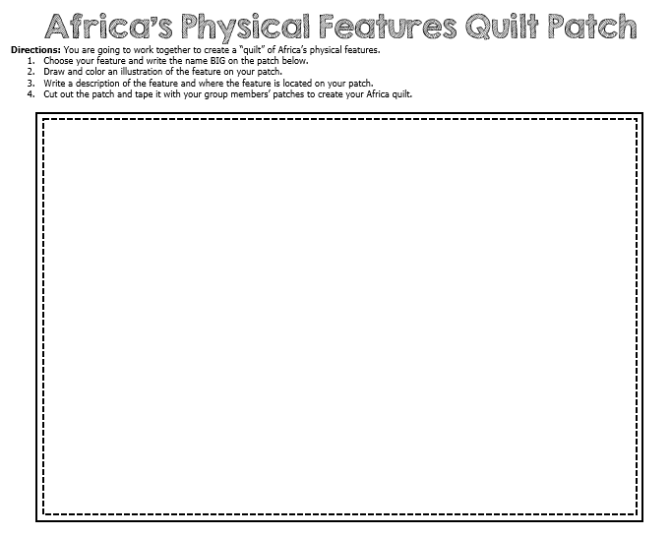

Slide 59
Physical Features Hot Seat Review –
Teacher Directions
Write the names of the 11 physical features on sticky notes and randomly place them under students’ chairs.
Have all students check their seats and if they have a feature, they have to either describe it or say where it’s located.
  Another variation—project a blank map of Africa on the board & have students place the sticky where the feature is located.

Slide 60
Teachers
Thank you for downloading this file. I hope you enjoy using it with your students, and I can’t wait to read your feedback in my TPT store! ☺
For more social studies materials, please visit my store: http://www.teacherspayteachers.com/Store/Brain-Wrinkles
I teach 6th grade Language Arts and Social Studies in Georgia, so my products are aligned with Common Core (LA) and Georgia Performance Standards (SS).
© Copyright 2013. Brain Wrinkles. All rights reserved. Permission is granted to copy pages specifically designed for student or teacher use by the original purchaser or licensee. The reproduction of any other part of this product is strictly prohibited. Copying any part of this product and placing it on the Internet in any form (even a personal/classroom website) is strictly forbidden. Doing so makes it possible for an Internet search to make the document available on the Internet, free of charge, and is a violation of the Digital Millennium Copyright Act (DMCA).

Slide 61


Credits:
All photos were found via Creative Commons and labeled for reuse.
Fonts:
Backgrounds & Graphics:

